Slide 1
Insurance Premium Renewal Propensity
Capstone Project Presentation- Group 3

Slide 2
Introduction
Problem Statement
“To assist an insurance company build a model to predict the propensity of customers to NOT pay renewal premium and thereby preempt revenue loss.”
Project Objectives & Scope
Identify factors influencing customer churn
Predict customer propensity of default
Recommendations to avert financial loss

Slide 3
Executive Summary-1
Data Discovery:
~80K observations, 16 predictor & 1 target variable
No missing/null values, evidence of outliers & skewness
Key Findings:
6% customers do not renew premium. Revenue loss pegged at INR 4 Crores or 5% of overall revenue
Highest opportunity lies in customers of age group 26-40 years since they represent 21% of customer base and are 1.4x likely to churn than overall population
Low income customers churn most at 9%

Slide 4
Executive Summary-2
Key Findings:
60% of customers who default have paid over half their premiums via cash
Customers who pay a low premium have highest non-renewal percentage (9%) and represent 21% of customer base
Customer who default have a late payment history
Top predictors for default are percentage premium paid in cash, income, age and risk score
Optimized model has potential to predict 57% of potential premium loss due to default

Slide 5
Executive Summary-3
Recommendations:
Marketing benefits of timely renewal payment
Monitoring and timely payment reminders to customers
Advertising benefits of premium payment to customers who are nearing policy maturity
Introduction to digital, instalment-based and credit forms of payment for faster and easier premium payment

Slide 6
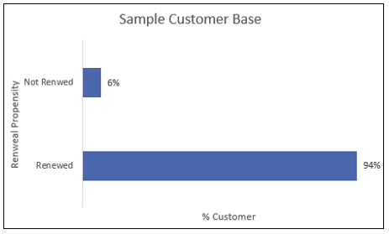

Exploratory Data Analysis-1
Customer Base
94% have renewed their insurance premium versus 6% who have not renewed
Revenue loss due to non-renewal of premium is 4 Crores which is about 5% of overall revenues in terms of premium

Slide 7
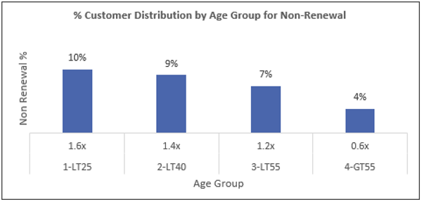

Exploratory Data Analysis-2
Distribution of Churned Customers by Age Group
Lower aged customers more likely to default
Age group 26-40, 1.4x more likely to churn w.r.t. overall population
This age group represent ~21% of total customer base & presents biggest opportunity

Slide 8
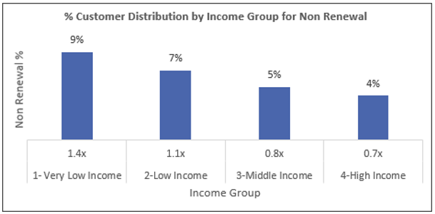
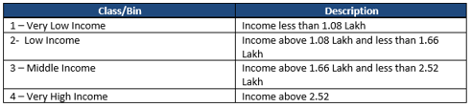
Exploratory Data Analysis-3
Distribution of Churned Customers by Income
Very low income customers churn most at 9% (w.r.t. 6% portfolio non-renewal percentage)
Customers in the high income group are less likely to churn while those in very low and low income groups are 1.4x and 1.1x more likely to churn

Slide 9
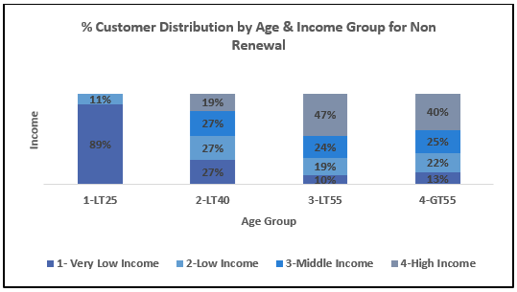
Exploratory Data Analysis-4
Distribution of Churned Customers by Age & Income
Customers in very low income group churn the most in <25 years group
Customers in age bracket 26-40 years 19% have high income though they churn. This trend persists in 40-55 years and > 55 years groups too

Slide 10
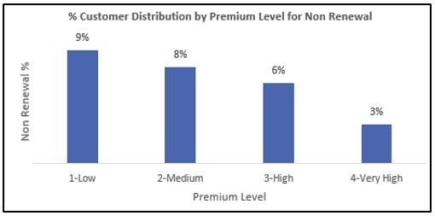
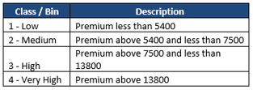
Exploratory Data Analysis-5
Distribution of Churned Customers by Premium Level
Customers paying very high premium are less likely to churn
Customers paying Low premium have highest non-renewal percentage (9%) and likely to churn the most (1.5x)
Customers in medium premium level offer greatest opportunity since they are 1.2x more likely to churn and represent 18% of customer base

Slide 11
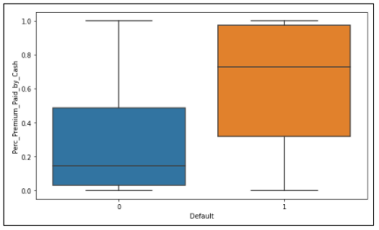
Exploratory Data Analysis-6
Percentage Premium paid by cash versus renewal propensity
Customers who do not renew pay more by cash versus people who renew who pay more by credit

Slide 12
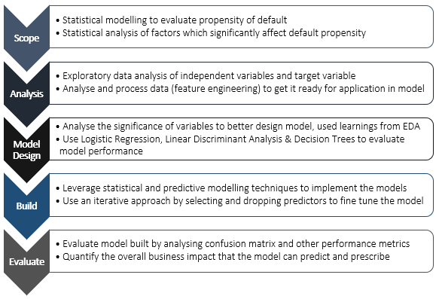
Predictive Modelling
Modelling Framework
Classification Modelling Techniques
Logistic Regression
Linear Discriminant Analysis
Decision Trees

Slide 13
Statistical Modelling Inferences
Variable Selection–p value
All but three having positive regression coefficients
Eight insignificant variables identified
Attribute Relevance -Information value
Age, Risk Score
Variable Importance – Regularized CART
Income, Age, Risk Score
Premium paid by Cash
No. of premiums paid
Variation Inflatory Factor
No multicollinearity
Low correlation (from correlation)

Slide 14
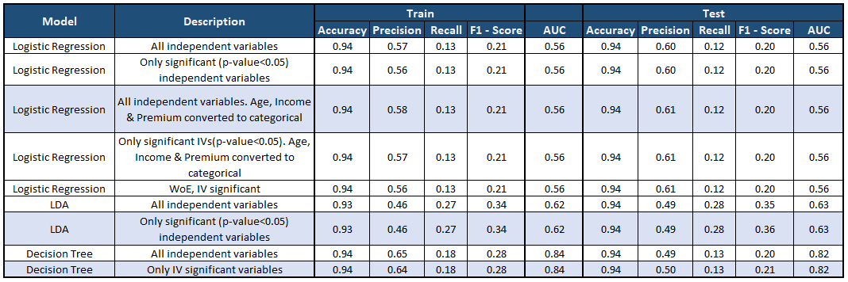
Predictive Modelling-1
Results from initial Predictive Modelling Techniques
Best performing models are highlighted

Slide 15
Predictive Modelling-2
Key take-aways from initial Predictive Modelling
Need a model with a low False Negative and hence KPI is Recall to evaluate models
Want to avoid missing customers who are actually going to churn and that is why we prefer Recall
Due to imbalance in dataset, necessary to evaluate models on F1 Score
LDA with significant variables performed best

Slide 16
Model Optimization-1
Feature Engineering:
Ratios: Amount per Premium, Premium to Income
Sum: Count of months late column
No change in results
SMOTE:
Imbalanced data - 6% of the data representing default
20% strategy
Resulting models overfit

Slide 17
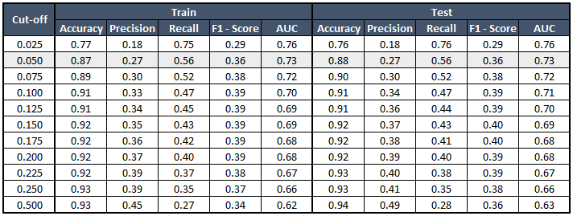
Model Optimization-2
LDA with Custom Cut-Off
Calculated metrics for different cut off values to determine optimum cut-off
Significant independent variables only were considered
Best model is highlighted

Slide 18
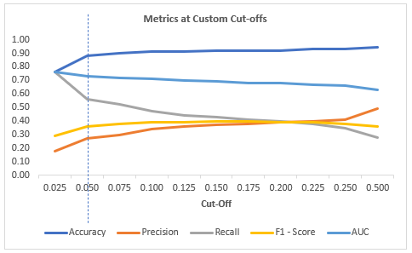
Model Optimization-3
LDA with Custom Cut-Off
Cut off = 0.05 optimum
Considering recall to keep the false negatives to a minimum
Predicting least number of actual defaulters as non-defaulters

Slide 19
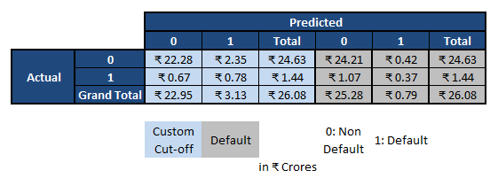
Quantification of Business Impact
LDA with Custom Cut-Off
Correctly predict premium loss of INR 78 Lakhs due to default
Potentially identify premium revenue worth 2.6 Crores as risk of premium losses

Slide 20
Conclusion
LDA with cut off of 0.05 predicts 57% of potential premium loss due to customer default
Percentage premium paid in cash, income, age and risk score are the top predictors of customer default
Insurance company recommended to cyclically monitor customer behaviour, adopt digital premium payment options
Recommended more data is collected moving forward in terms of observations and predictors to arrive at more stable model

Slide 21
Thank you!
Q&A

Slide 22
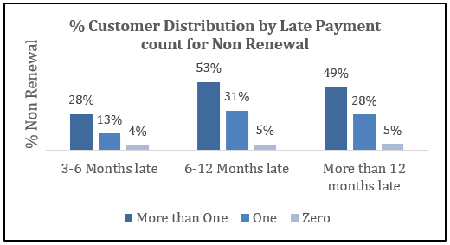
Exploratory Data Analysis
Distribution of Churned Customers by Late Payments
Customers who default have a previous history of more than one late payment

Slide 23
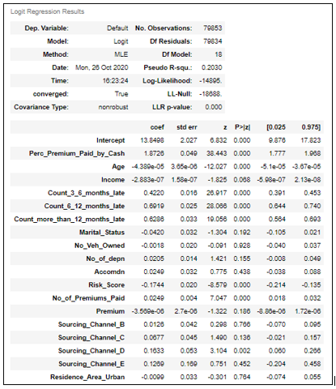
Statistical Modelling
Variable Selection using p-value
McFadden R square with all variables is 0.2030
Only 20.3% variability in the dependent variable explained by independent variables
This model performs poorly vis-à-vis industry standards
8 Insignificant variables identified

Slide 24
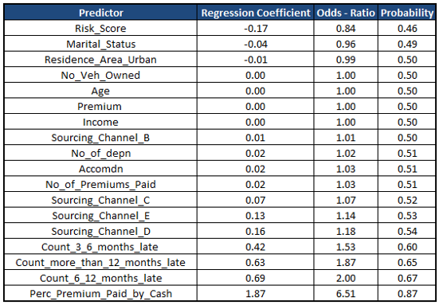
Statistical Modelling
Interpreting Regression Coefficients
Except three, the predictors are positive indicating that as values for these predictors increase, probability of default also increases
For every unit increase in the level of these predictors, the increase in odds of default is as in the table

Slide 25
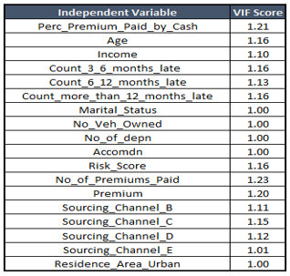
Statistical Modelling
Multi-collinearity
None of the independent variables have a high VIF
There is no evidence of Multicollinearity

Slide 26
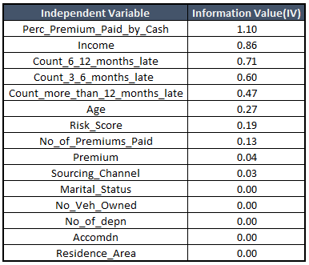
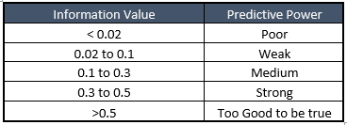
Statistical Modelling
Variable Selection using Information Values / Weight of Evidence
Attribute relevance analysis using weight of evidence and information value

Slide 27
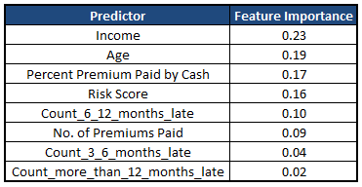
Statistical Modelling
Variable Selection using Variable Importance
Income, Age, Premium paid by cash, and Risk Score are important variables that effect non renewal propensity

Slide 28
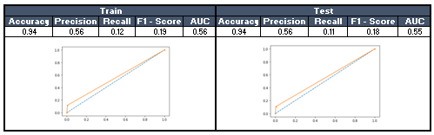
Model Optimization
Feature Engineering
Logistic regression post converting some independent variables into ratios and sums
Ratios: Amount per Premium, Premium to Income
Sum: Count of months late column
No major change in results

Slide 29
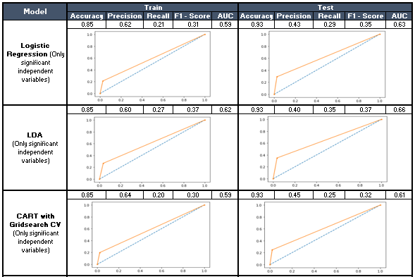
Model Optimization
Imbalanced data handling with SMOTE
Imbalanced data - 6% of the data representing default
Used synthetic minority oversampling technique with a 20% strategy
Observed models to be over-fit

Slide 30
Recommendations
Marketing benefits of timely renewal payment and reminders to customers in the age bracket 26-40 years
Targeted marketing campaigns with benefit and value proposition is recommended for all age group customers in the high income bracket (since these customer do not default due to dearth of income)
Advertising benefits of premium payment to customers who are nearing policy maturity (in the 40+ age bracket since they have a high churn percentage- 40%)
Customers be introduced to digital, instalment-based and credit forms of payment for faster and easier premium payment
Customers who have defaulted in the past need to be monitored and reminders sent since they are more likely to default again and churn

Slide 31
Applications
Use Case
Churn Modelling
Marketing Effectiveness Model
Pricing Optimization Model
Loss likelihood Analysis
Rating & Actuarial Analysis
Corporate Finance/Billing Analytics
Agent Performance
Product Development
Targeted Marketing Opportunity
Underwriting Improvements

Slide 32
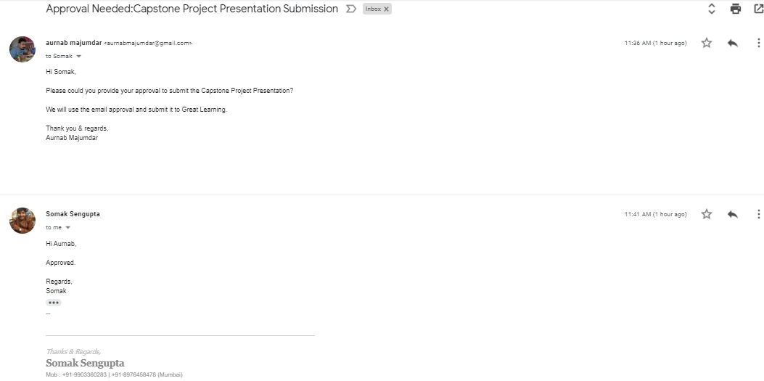
Certificate of Completion
This is to certify that the participants, Kavita Singh, Manisha Police, Sai Vishwanath Goud, Kishore Kalavakolanu, and Aurnab Majumdar, who are the students of Great Learning, have successfully completed their project on Insurance Renewal Propensity.
This project is the record of authentic work carried out by them during the academic year 2019-21.
Mentor: Somak Sengupta
Date: 2nd January 2021
Place: Kolkata

